Slide 1
Basics of Polysomnography
(PSG) Testing
Copyright 2006 Compumedics Ltd.

Slide 2

The following presentation is being provided for informational and educational purposes only. While Compumedics endeavors to ensure the validity and accuracy of the information within, we cannot be held responsible for inaccuracies, opinions or practices that often vary between various experts or are without established acceptable medical standards. Please consult your own medical director for clarification or for policies that are specific to your facility.
We welcome your comments, suggestions and corrections. Please
e-mail your comments to: marketing@compumedics.com.au
Copyright 2006 Compumedics Ltd.

Slide 3
Why Perform Sleep Studies?
Quantify sleep pattern
Determine cause of excess daytime sleepiness
Initialize and evaluate treatment
Evaluate treatment effectiveness
Copyright 2006 Compumedics Ltd.

Slide 4
Types of sleep studies
Diagnostic - investigative study to determine if there are identifiable problems with the patient’s sleep
CPAP titration - Once a patient is identified as having sleep apnea, another study is performed in which the technician adjusts the CPAP level during the test
Split Night - Combines a diagnostic study and a CPAP titration study into one night. The patient is diagnosed during the first half of the night; CPAP applied the second half if required by protocol
MSLT - Multiple Sleep Latency Test
MWT – Maintenance of Wakefulness Test
Copyright 2006 Compumedics Ltd.

Slide 5
Diagnostic Sleep Studies –
Variables Evaluated
Sleep staging
  Wake, NREM (1,2,3,4), REM
  Arousals
Respiratory
  Apneas and hypopneas
  Upper airway resistance
Limb EMG
  PLMS
  Restless legs
Copyright 2006 Compumedics Ltd.

Slide 6
Polysomnography (PSG)
Typical Montage
EEG C3-A2, EEG O1-A2, EOG(L), EOG(R), EMG (chin)
AIRFLOW, THOR RES, ABDO RES
SpO2,
ECG,
LEG(L), LEG(R)
SOUND, POSITION
CPAP pressure
Optional: additional EEG, dB meters, temperature, blood pressure
Copyright 2006 Compumedics Ltd.

Slide 7
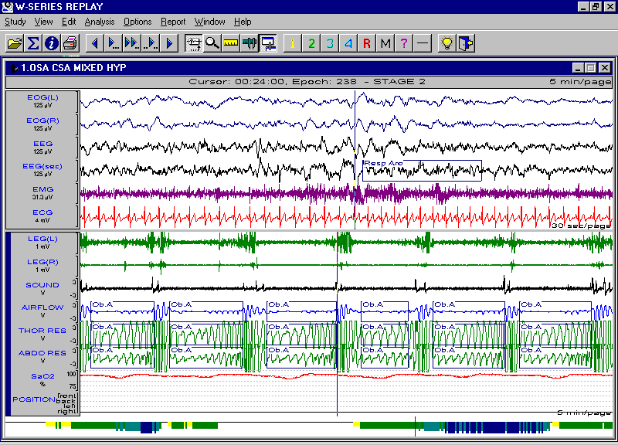
Typical Polysomnogram
Copyright 2006 Compumedics Ltd.

Slide 8
Sleep Architecture
  Normal?
  Deficient in REM?
  Contain supine REM?
  Deficient in Delta sleep?
  Fragmented or disrupted by frequent arousals?
Copyright 2006 Compumedics Ltd.

Slide 9

Normal Sleep Architecture
Entered through NREM
Approximately 90 minute cycle including NREM and REM
Slow wave dominates first third of night
REM sleep dominates last third of night
REM sleep: 20-25% total sleep time
Copyright 2006 Compumedics Ltd.

Slide 10


Examples - Sleep Hynograms
Normal Sleep Architecture
No Delta (Restorative) Sleep
Severely Fragmented Sleep
Copyright 2006 Compumedics Ltd.

Slide 11
Sleep Staging Variables
Electroencephalogram (EEG) - acquired by surface electrodes on the scalp at standardized locations (10-20 system)
Electrooculogram (EOG) - acquired by surface electrodes placed at the outer canthus of each eye
Electromyogram (EMG) - acquired by surface electrodes placed on the chin muscle (sub-mental)
Copyright 2006 Compumedics Ltd.

Slide 12
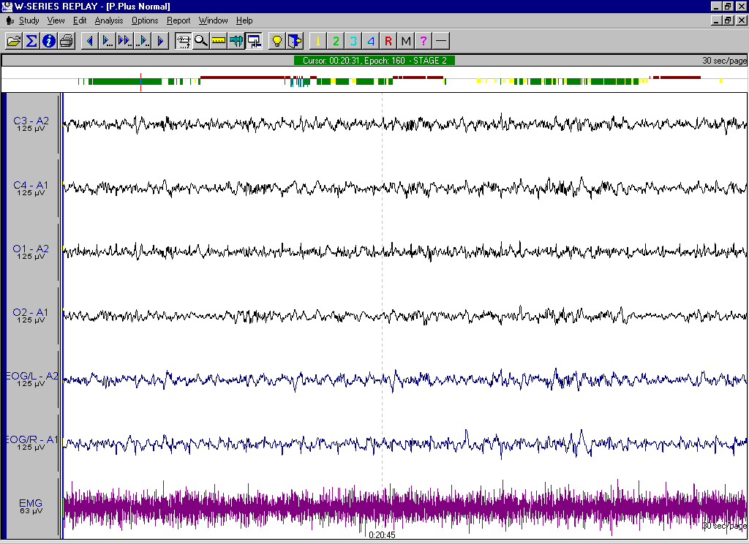
Sleep Staging Channels

Slide 13
EEG
Frequency and amplitude change with sleep stage:
Wake: high frequency
Stage 1, REM: low amplitude, mixed frequency
Stage 2: spindles, K-complexes
Stage 3/4: delta waves
Standard sleep epoch is 30 seconds (10 mm/sec paper speed)
Copyright 2006 Compumedics Ltd.

Slide 14
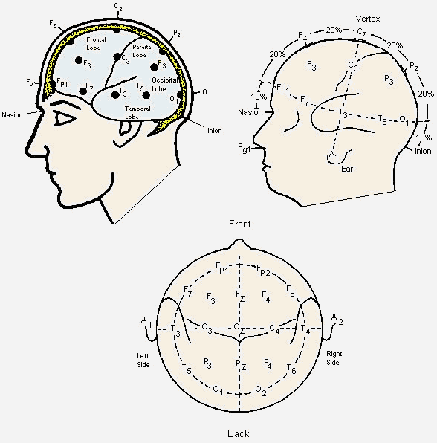
10-20 EEG Locations
Copyright 2006 Compumedics Ltd.

Slide 15
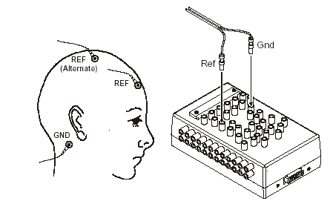
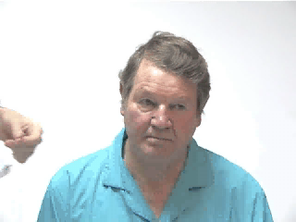
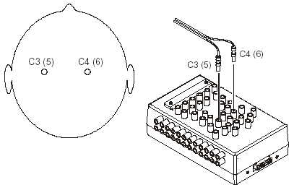
EEG Electrode Placement
Copyright 2006 Compumedics Ltd.

Slide 16



Sleep Stage Criteria
Awake
  alpha or faster > 50% of epoch
  many eye movements
  high EMG
Stage 1
  alpha or faster < 50 % of epoch
  increasing theta activity
  slow rolling eyes
  vertex waves
ALPHA WAVES
THETA WAVES
VERTEX WAVE
Copyright 2006 Compumedics Ltd.

Slide 17

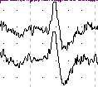
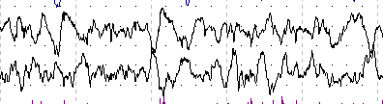
Sleep Staging Criteria
Stage 2
  Sleep spindles or K-complexes < 3 mins apart
Stage 3
  Delta-H 20-50% of epoch
Stage 4
  Delta-H > 50 % of epoch
DELTA WAVES
Copyright 2006 Compumedics Ltd.

Slide 18
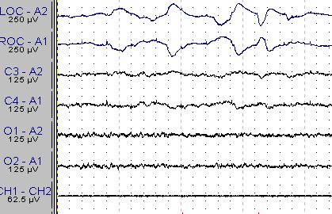
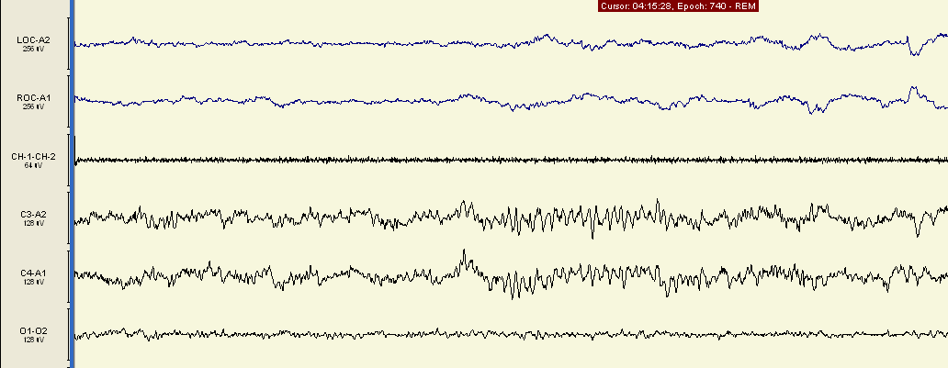
Sleep Staging Criteria
REM
  Lowest EMG
  Rapid Eye Movements
  Spindles or K-complexes > 3 mins apart
  Saw-tooth EEG
  Low-amplitude, mixed frequency EEG similar to stage 1
Copyright 2006 Compumedics Ltd.

Slide 19



EOG
EOG records voltage changes caused by eye movement
EOG changes with sleep stage
Wake: random, high amplitude
Stage 1: slow rolling
REM: very flat with occasional Rapid Eye Movements
Copyright 2006 Compumedics Ltd.

Slide 20
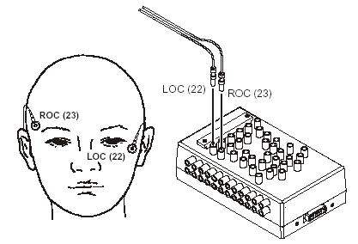
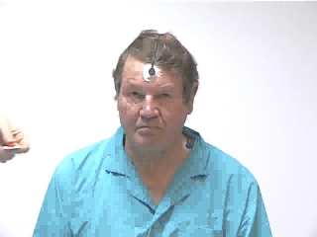
EOG Electrode Placement
Copyright 2006 Compumedics Ltd.

Slide 21

EMG
Recorded as the potential between two surface electrodes placed several centimeters apart
Typically, the chin (submental) muscle is used because it exhibits large differences during sleep, aiding in the identification of stages
Wake - high activity
Sleep - lower activity
REM sleep - paralysis of skeletal muscles
Copyright 2006 Compumedics Ltd.

Slide 22
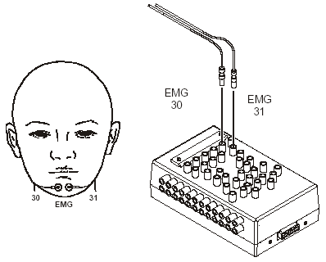
EMG Placement
Submental (chin)
Often a third under the chin
Copyright 2006 Compumedics Ltd.

Slide 23
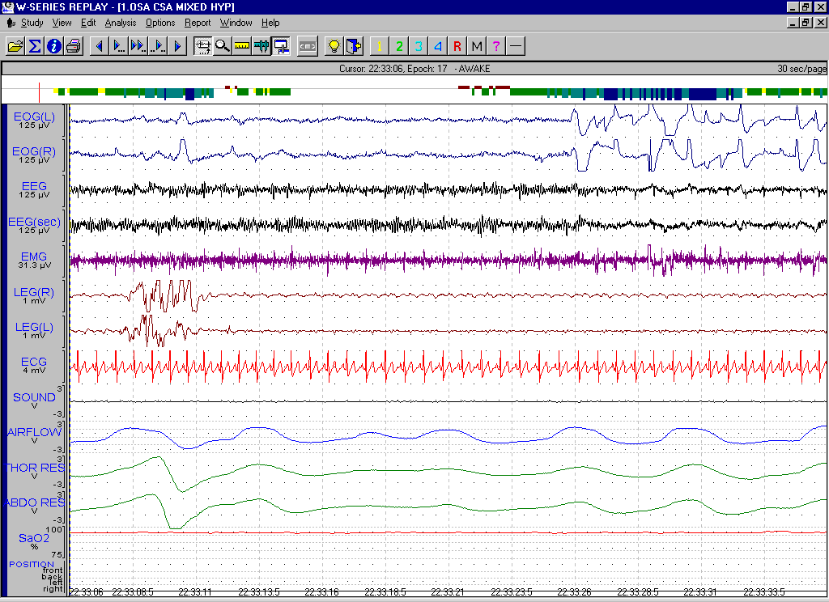
Wake
Copyright 2006 Compumedics Ltd.

Slide 24
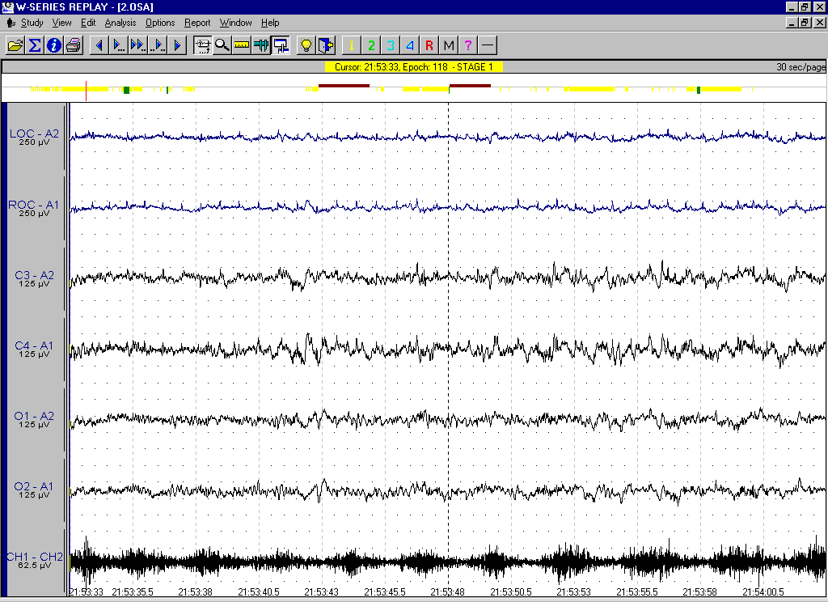
Stage 1 Sleep
Copyright 2006 Compumedics Ltd.

Slide 25
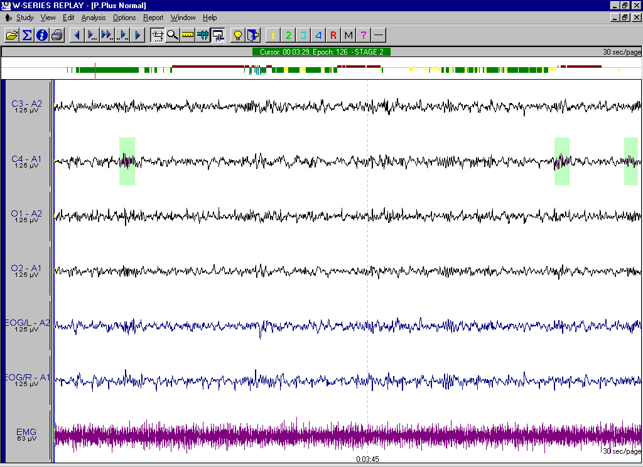
Stage 2 Sleep
Copyright 2006 Compumedics Ltd.

Slide 26
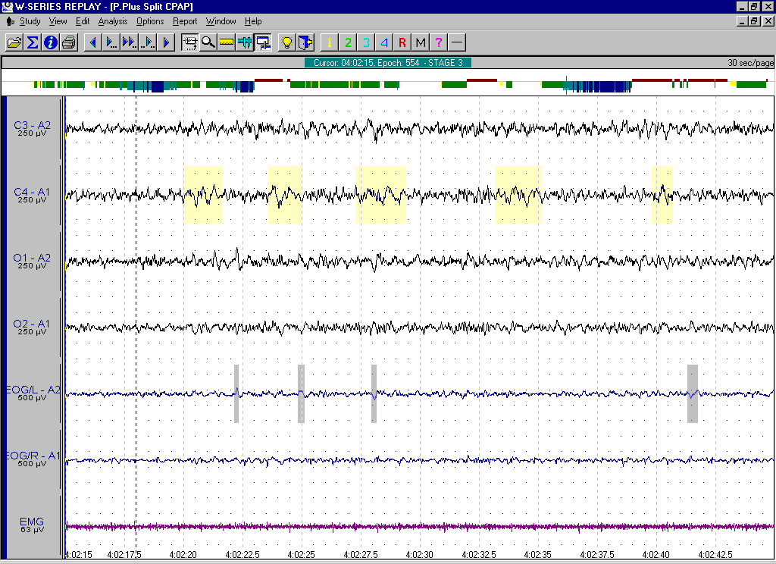
Stage 3 Sleep
Copyright 2006 Compumedics Ltd.

Slide 27
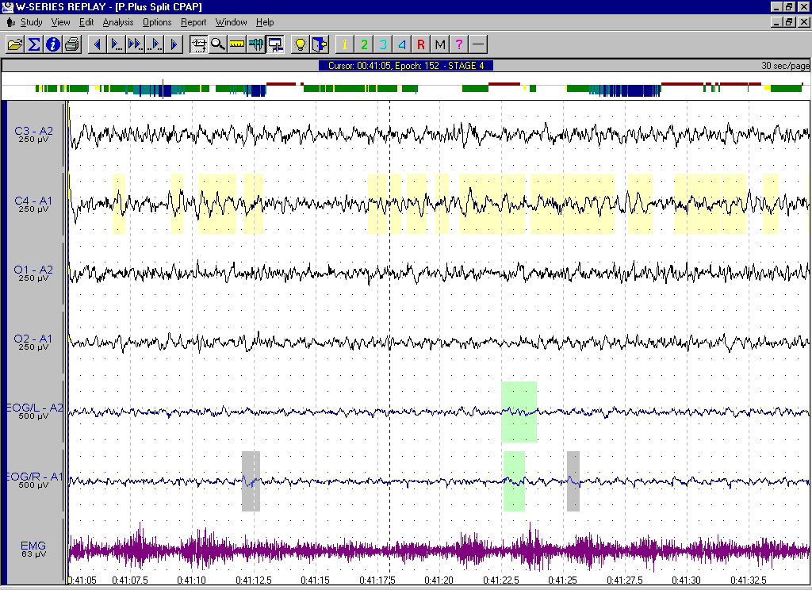
Stage 4 Sleep
Copyright 2006 Compumedics Ltd.

Slide 28
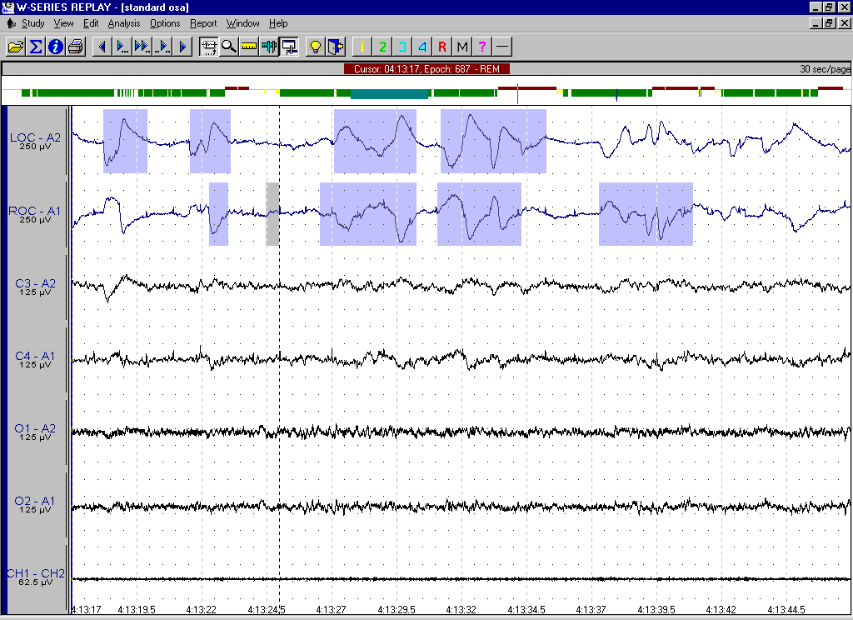
Stage REM Sleep
Copyright 2006 Compumedics Ltd.

Slide 29
Respiratory Variables
Respiratory effort (thoracic and abdominal)
Airflow (thermistor, thermocouple, nasal pressure, ETCO2)
SpO2
Snoring sounds
Optional signals
  ETCO2
  tcCO2
Copyright 2006 Compumedics Ltd.

Slide 30
Airflow
Used for detecting respiratory events
  Apnea: no airflow
  Hypopnea: reduced airflow
How is airflow commonly measured?
  Temperature changes: thermistor/thermocouple
  In/ex pressure changes: nasal cannula
  ETCO2
Copyright 2006 Compumedics Ltd.

Slide 31
Respiratory Effort
Used for classifying respiratory events
  e.g. Apnea: no airflow but effort indicates obstruction
Inductive plethysmography bands
Piezo-electric bands
EMG: diaphragm/intercostal
Esophageal pressure
Copyright 2006 Compumedics Ltd.

Slide 32
Other Respiratory Variables
Gases:
  SaO2
  tcCO2
  etCO2
  Arterial CO2
Copyright 2006 Compumedics Ltd.

Slide 33
Other Variables Typically Recorded
ECG
Leg movement: EMG, piezoelectric
Video
Body position
Copyright 2006 Compumedics Ltd.

Slide 34
Respiratory Events
Apneas
  Obstructive
  Central
  Mixed
Hypopneas - some labs categorize as apneas
Respiratory Event Related Arousals - RERA
  Respiratory event does not meet the criteria for event types above
  Causes a disruption of the sleep architecture
Copyright 2006 Compumedics Ltd.

Slide 35
Obstructive Apnea
Cessation of airflow, usually for more than 10 seconds
With abdominal and/or thoracic effort
Usually terminated by an arousal and/or associated with a desaturation
Copyright 2006 Compumedics Ltd.

Slide 36
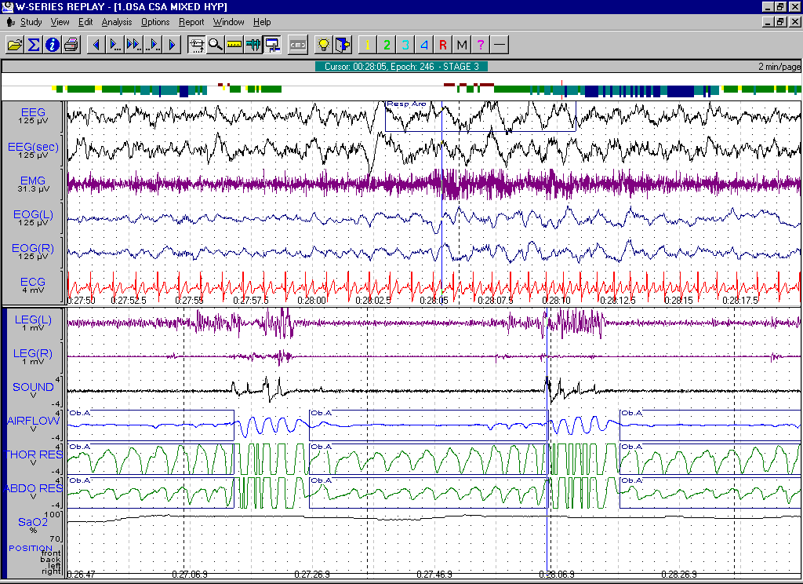
Example - Obstructive Apnea
Copyright 2006 Compumedics Ltd.

Slide 37
Central Apnea
Cessation of airflow, usually for more than 10 seconds
Without abdominal and/or thoracic effort
May be terminated by an arousal and/or associated with a desaturation
Very different type syndrome than OSA; chemo-receptor irregularities
Copyright 2006 Compumedics Ltd.

Slide 38
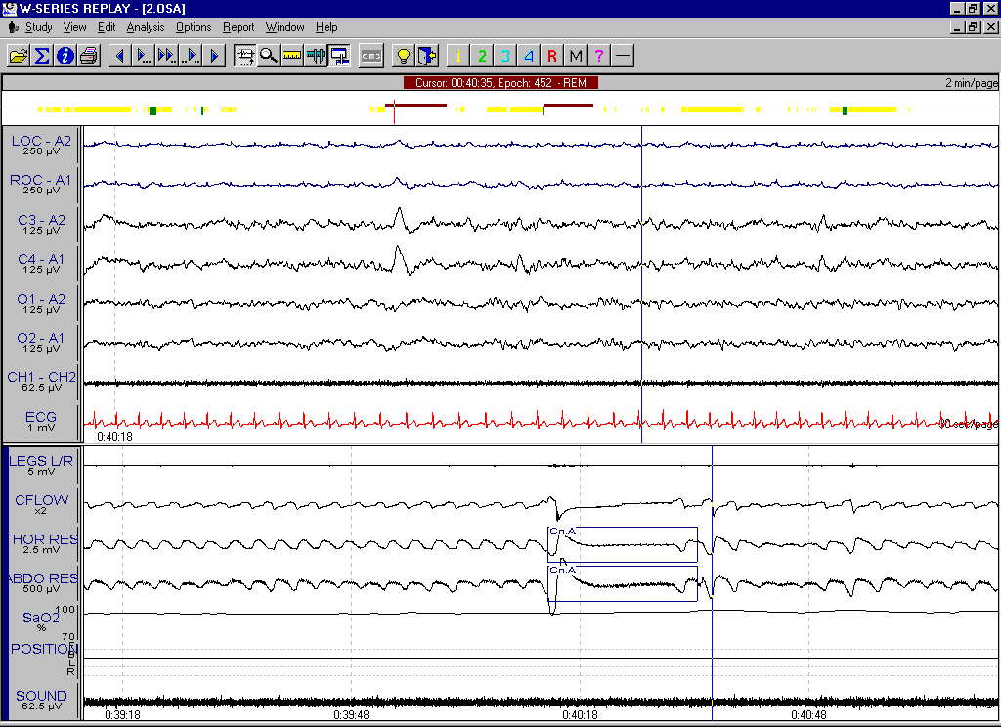
Example - Central Apnea
Copyright 2006 Compumedics Ltd.

Slide 39
Mixed Apnea
  Cessation of airflow >10 s (in adults) with respiratory effort
  Contains both central and obstructive components, with each component lasting at least one normal respiratory cycle
  Typically leads to a desaturation and an arousal
  Is really just a type of obstructive event with the same consequences
Copyright 2006 Compumedics Ltd.

Slide 40
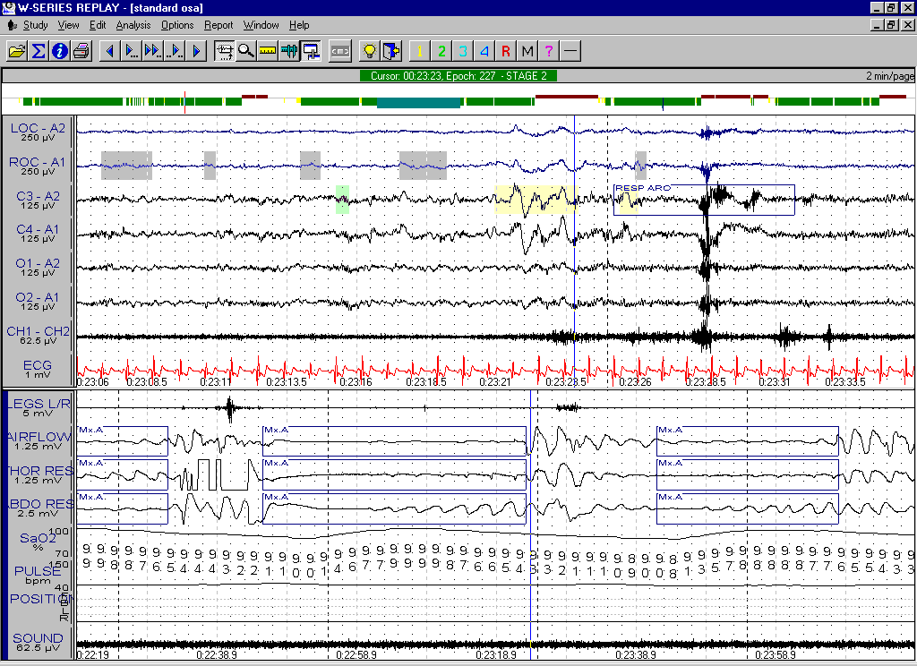
Example - Mixed Apnea
Copyright 2006 Compumedics Ltd.

Slide 41
Hypopnea
Reduced airflow, usually for more than 10 seconds
Many labs require at least a 50% reduction in flow; however, more and more labs do not require a specific % reduction, but look at the SaO2 and EEG to affect the decision
May be terminated by an arousal and/or associated with a desaturation
Copyright 2006 Compumedics Ltd.

Slide 42
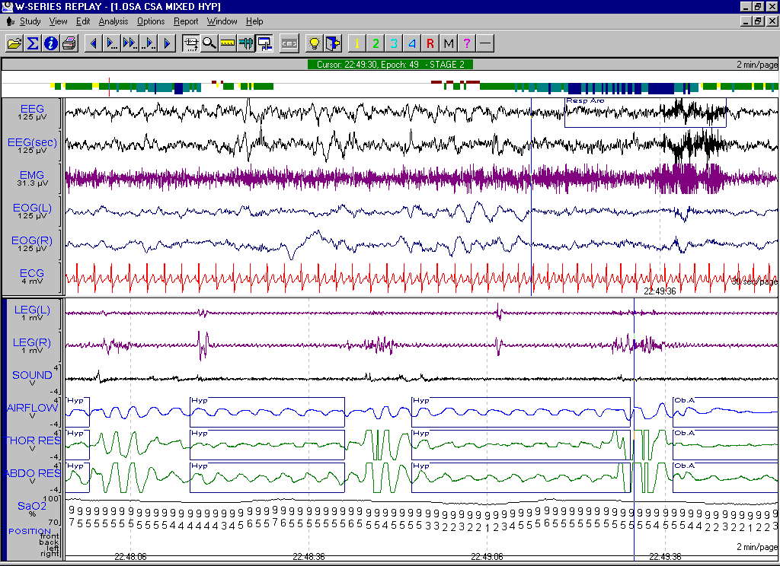
Example - Hypopnea
Copyright 2006 Compumedics Ltd.

Slide 43
PLMS
Repetitive (at least 4) episodes of muscle contraction (0.5-5 s duration), typically separated by 20-40 seconds, but not more than 90 seconds (120 seconds in some laboratories)
Arousals sometimes associated with the movements
Positive diagnosis if more than 5 per hour of sleep
Movements may be determined to be not clinically significant if not associated with arousals
Copyright 2006 Compumedics Ltd.

Slide 44
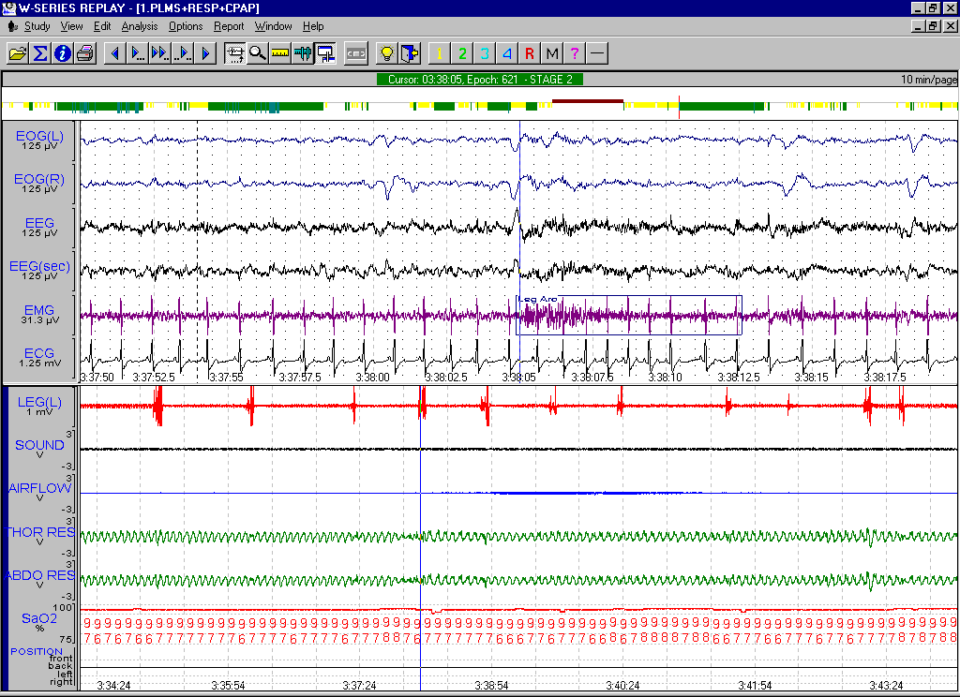
Example - PLMS
Copyright 2006 Compumedics Ltd.

Slide 45
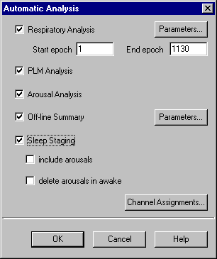
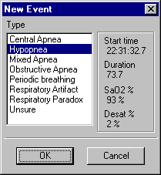
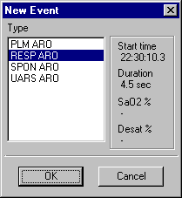
Basic Steps to Analyze a Study Using
Compumedics Software
1. Automatic Analysis
  Offline Summary
  Respiratory Scoring
  Sleep Staging
  Arousal Scoring
  PLM Scoring
2. Manual Editing
  Validate Sleep Staging
  Event Editing: Respiratory, PLM, and ECG
  Arousal Classification and editing
3. Reporting
4. Archiving
Copyright 2006 Compumedics Ltd.

Slide 46
Respiratory Events
Which events were most common?
Were there any obstructive events?
What was the RDI?
What was the nadir and baseline SaO2?
Was any snoring recorded?
Copyright 2006 Compumedics Ltd.

Slide 47
Leg Movements
Were they periodic?
Did they cause arousals?
Were they associated with respiratory events?
Copyright 2006 Compumedics Ltd.

Slide 48
Arousals
ASDA¹ (1992)
  Increase in EEG frequency for > 3 seconds
  In REM, must include increase in EMG
Cheshire² (1992)
  A return of alpha or theta rhythm for > 1.5 s
  Associated with a transient (however brief) increase in EMG
^{1 Sleep 15:174-184, 1992}
2 Arch Intern Med 152:538-541, 1992
Copyright 2006 Compumedics Ltd.

Slide 49
Arousals
How many per hour?
Related to events??
  Respiratory events
  Leg movements
  Esophageal reflux
  Seizures
  Unknown
Copyright 2006 Compumedics Ltd.

Slide 50
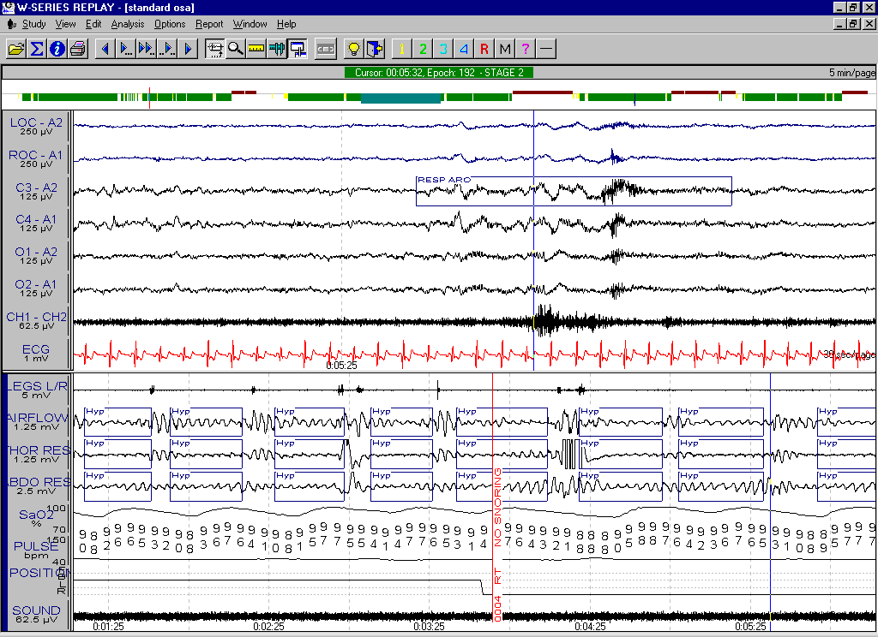
Example - Respiratory Related Arousal
Copyright 2006 Compumedics Ltd.

Slide 51
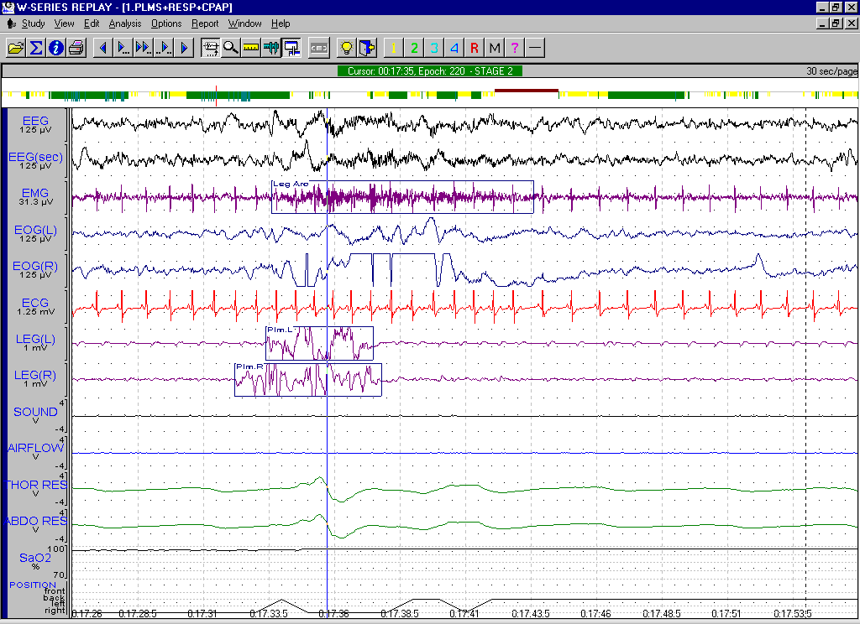
Example - PLM Related Arousal
Copyright 2006 Compumedics Ltd.

Slide 52
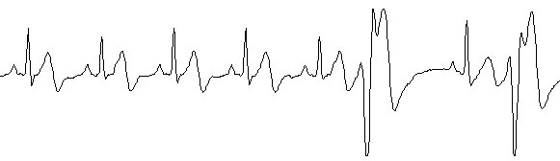
ECG
Normal sinus rhythm?
Bradycardia or Tachycardia?
Frequent atrial/ventricular arrhythmias?
Run of 5 or more ventricular arrhythmias?
Copyright 2006 Compumedics Ltd.

Slide 53
CPAP
Effective?
Best pressure?
Best mask?
Tolerance?
Copyright 2006 Compumedics Ltd.

Slide 54
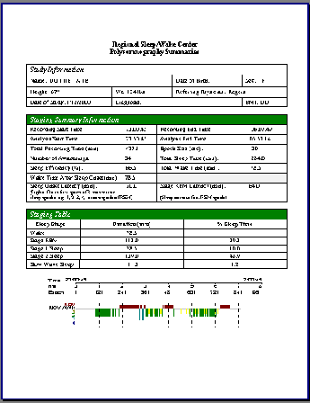
Reporting Sleep Studies
Generate report
Write results summary
Save
Print
Print raw data examples
Add doctors summary
File and send to referring doctors
Copyright 2006 Compumedics Ltd.

